Slide 1
Anomaly detection with Autoencoder
to detect Spoofing attack on GNSS

Slide 2
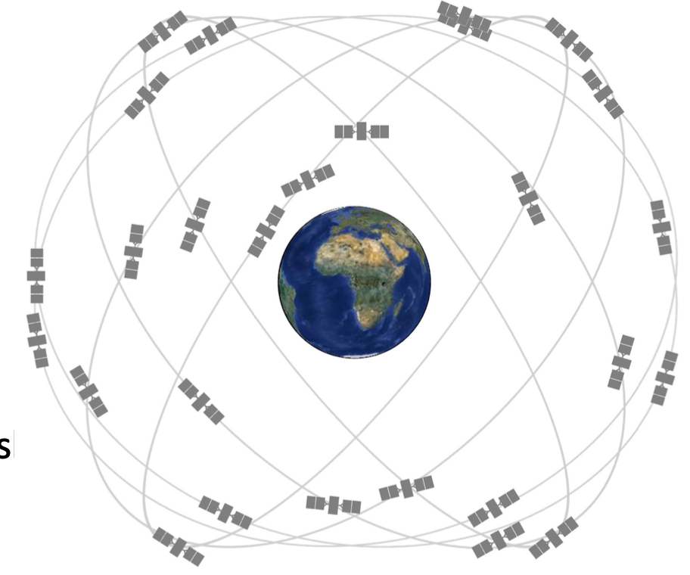

What is GNSS(Global Navigation Satellite Systems)
US GLobal Positioning System
Russian GLONASS
European Galileo
Chiese BeiDou
Other augmentations
GPS Constellation

Slide 3
Principles
• Trilateration & Time of arrival – If signal velocity is known, range from the transmitter to receiver is measured by v*(trec – ttrans). – Position is determined by intersection of circular lines of positions centered on the transmitters. – Must assume perfect clock for this work
• Doppler positioning and frequency shift – As the transmitter approaches the frequency is shifted higher due to Doppler effect (relativity). – At the point of closest approach the shift is zero, and it goes lower as the transmitter moves away. – If the trajectory of the transmitter is known, you can get 1D or 2D position information from this measurement and its rate of change.
GPS Constellation

Slide 4
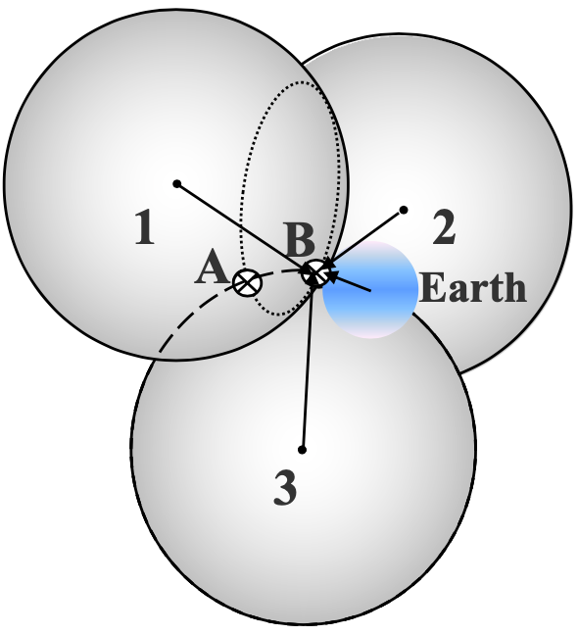
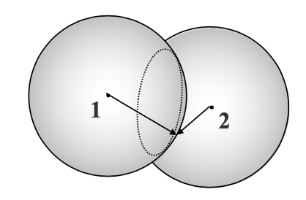
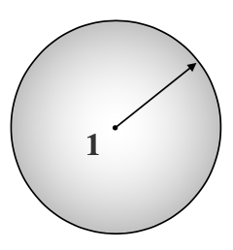
Trilateration for GNSS
1 satellite
2 satellites
3 satellites

Slide 5
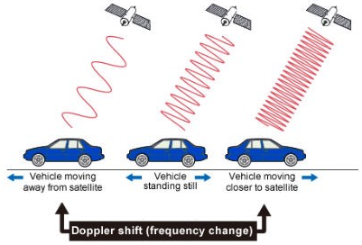
Doppler Shift for GNSS
GPS Constellation

Slide 6
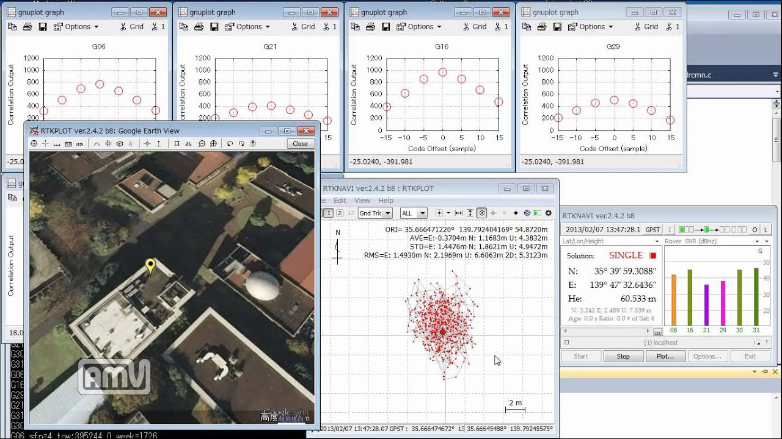

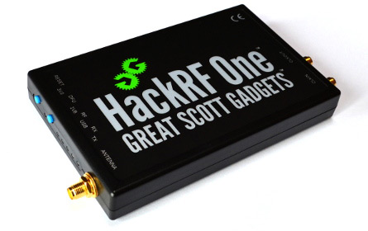
Why GNSS-SDR
GNSS-SDR is
Hosted by non-profit research foundation(cttc)
It enables Software defined radio to receive and process GNSS signals

Slide 7
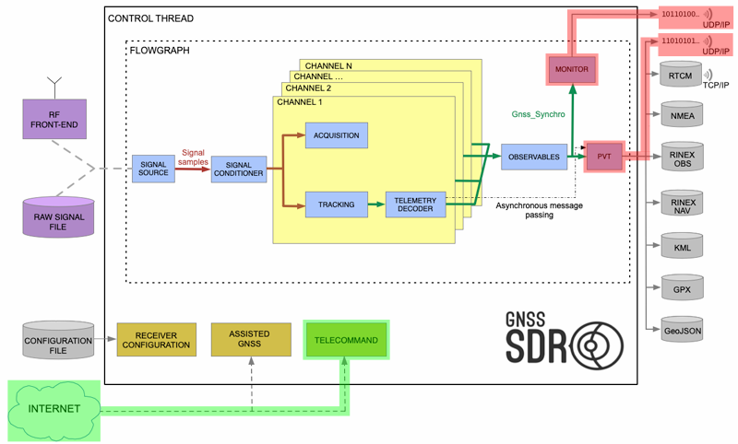
GNSS-SDR Structures (= General GNSS receiver)
GPS Constellation

Slide 8
Threats in GNSS
Spoofing :
Deceive receivers who are tracking a channel with strong signal
Jamming :
Propagate the signal which has same frequency with current receiving signal which potentially overwhelm the original signal
Meaconing :
Record the normal signal and replay it

Slide 9
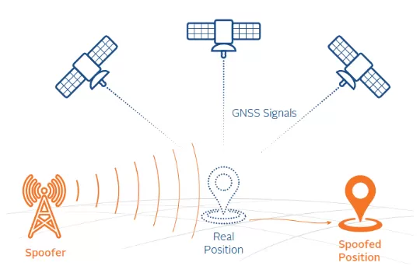
Spoofing in GNSS
> 30,000km
< 100km

Slide 10
Why GNSS is vulnerable to Spoofing attacks
Distance :
Signal from satellite (30,000km) cannot beat spoofing signal(100km)
Publicity :
GNSS is generally open to public(PRN code)
Authentication :
Once start tracking, the GNSS receiver do not check the signal source

Slide 11
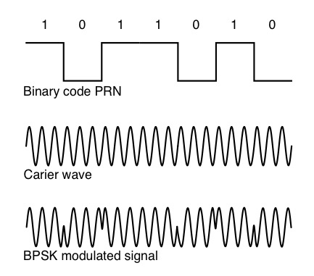
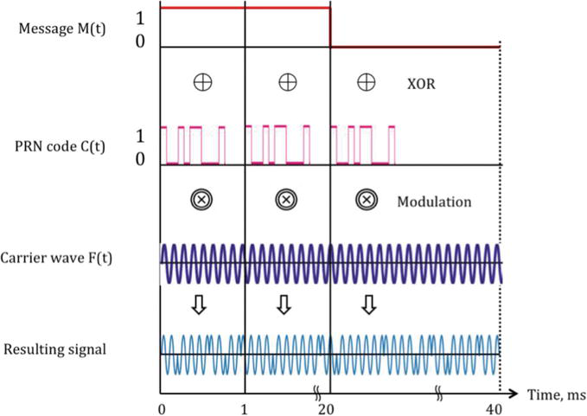
Signal modulation in GNSS

Slide 12
Why Spoofing attack is detectable
So many variables in GNSS signal :
Position info : Satellite’s trajectory, position info
Time info : The time when the signal is sent
Signal feature info
ex) C/N0 : Signal to noise ratio
Pseudorange : Calculated distance from Doppler shift
➡️What if utilize multiple variables to build anomaly detection model?

Slide 13
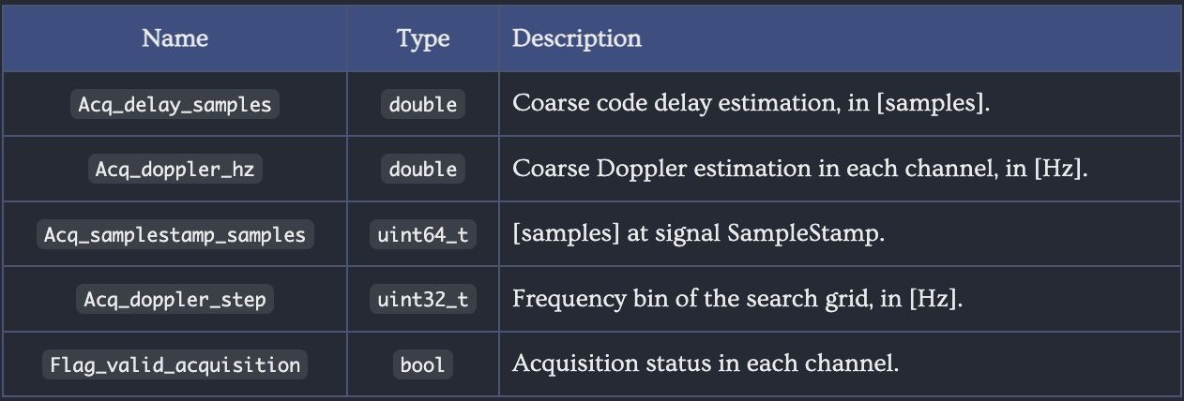
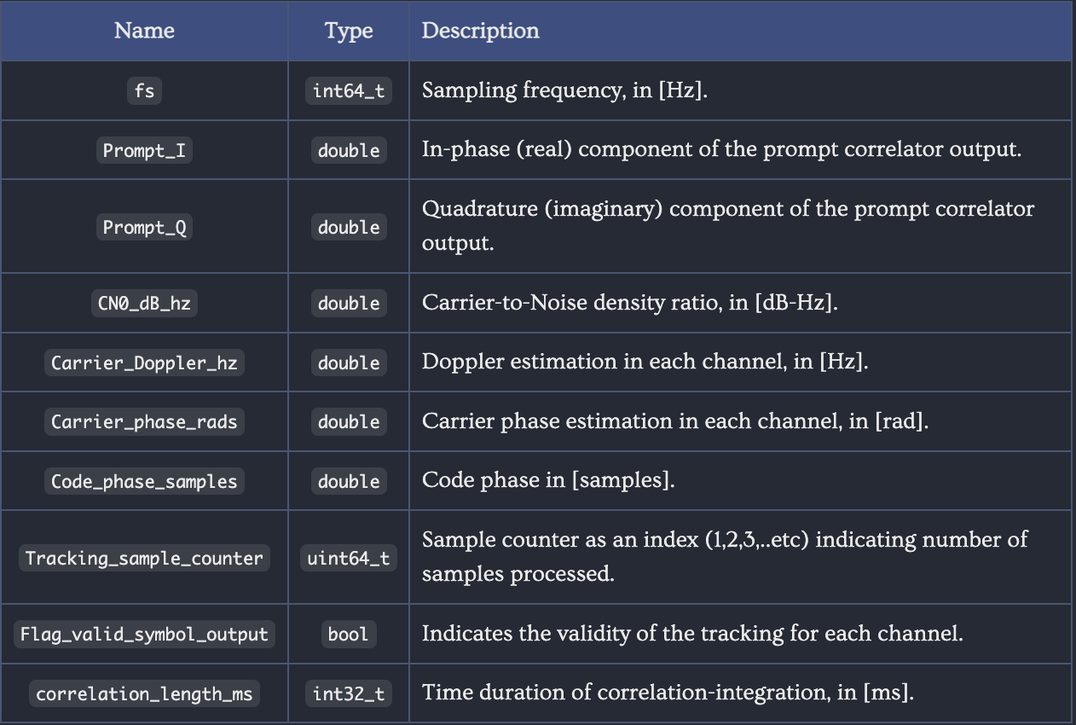
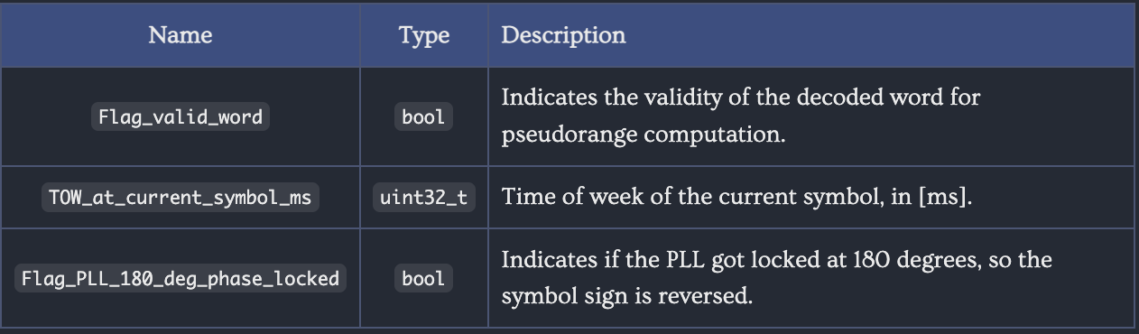
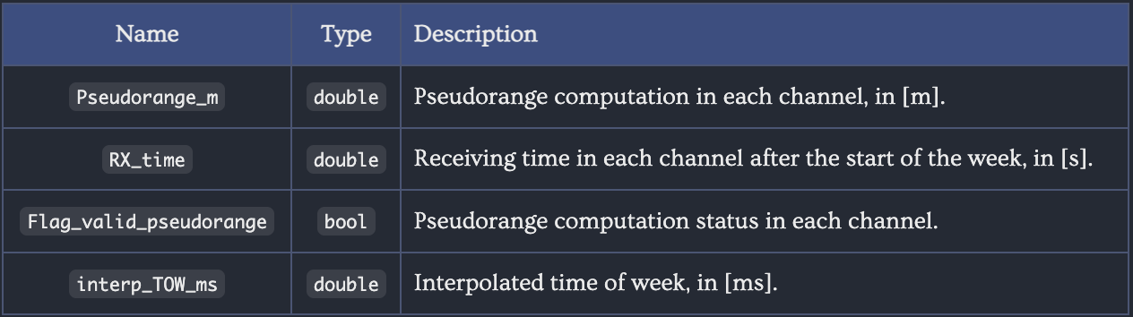
Variables from GNSS-SDR

Slide 14
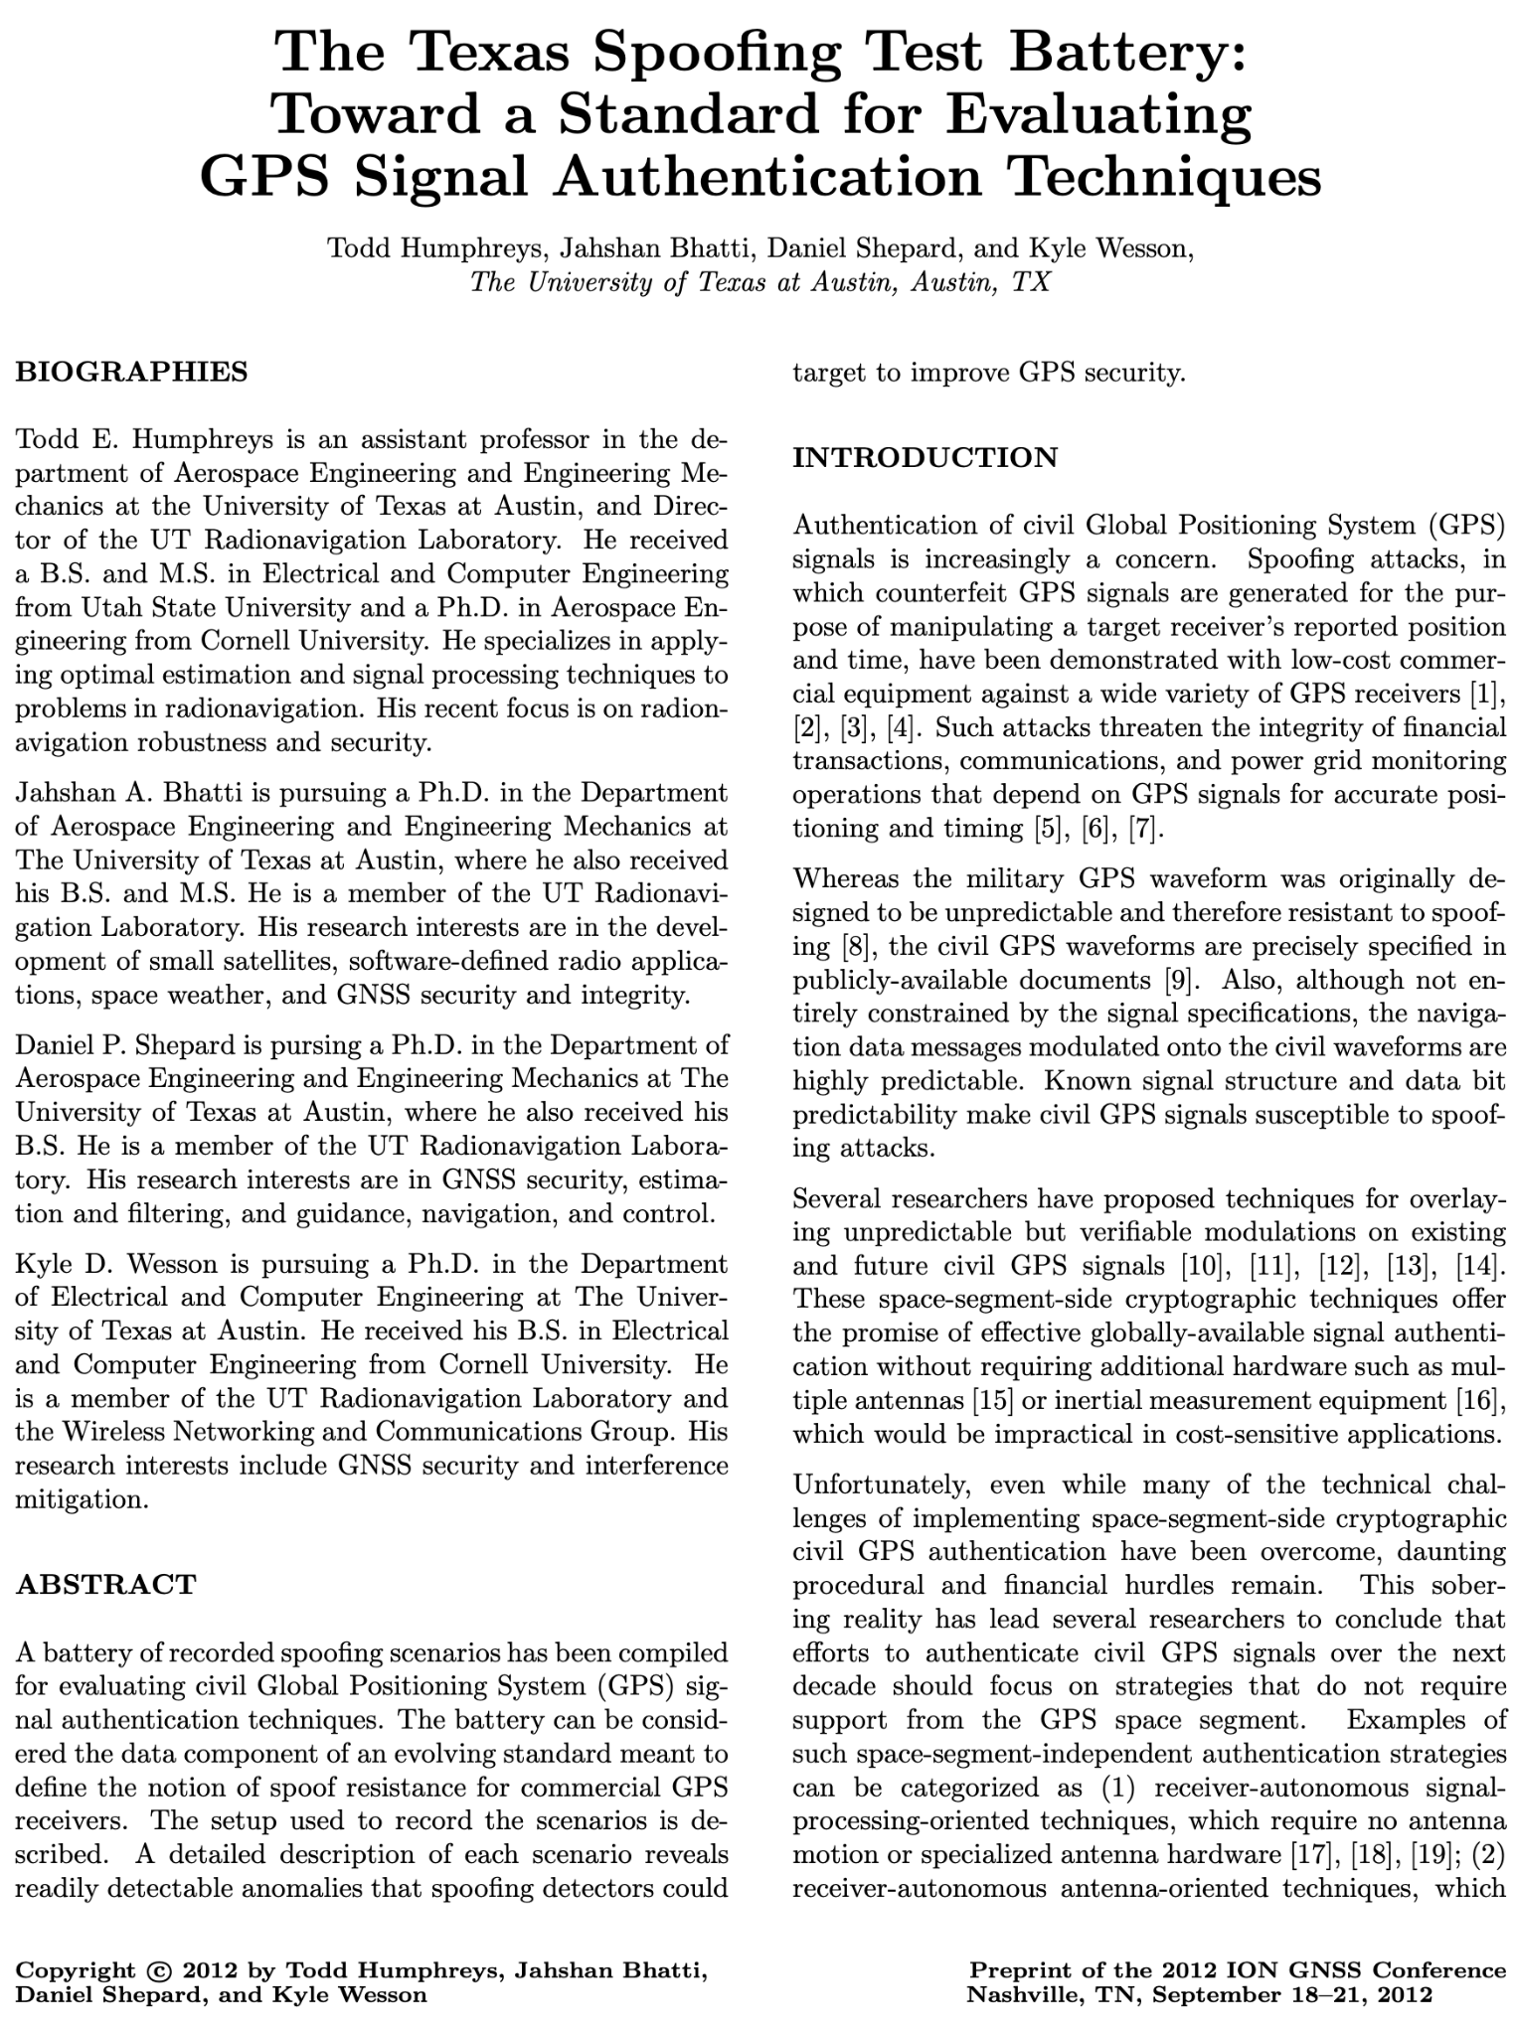
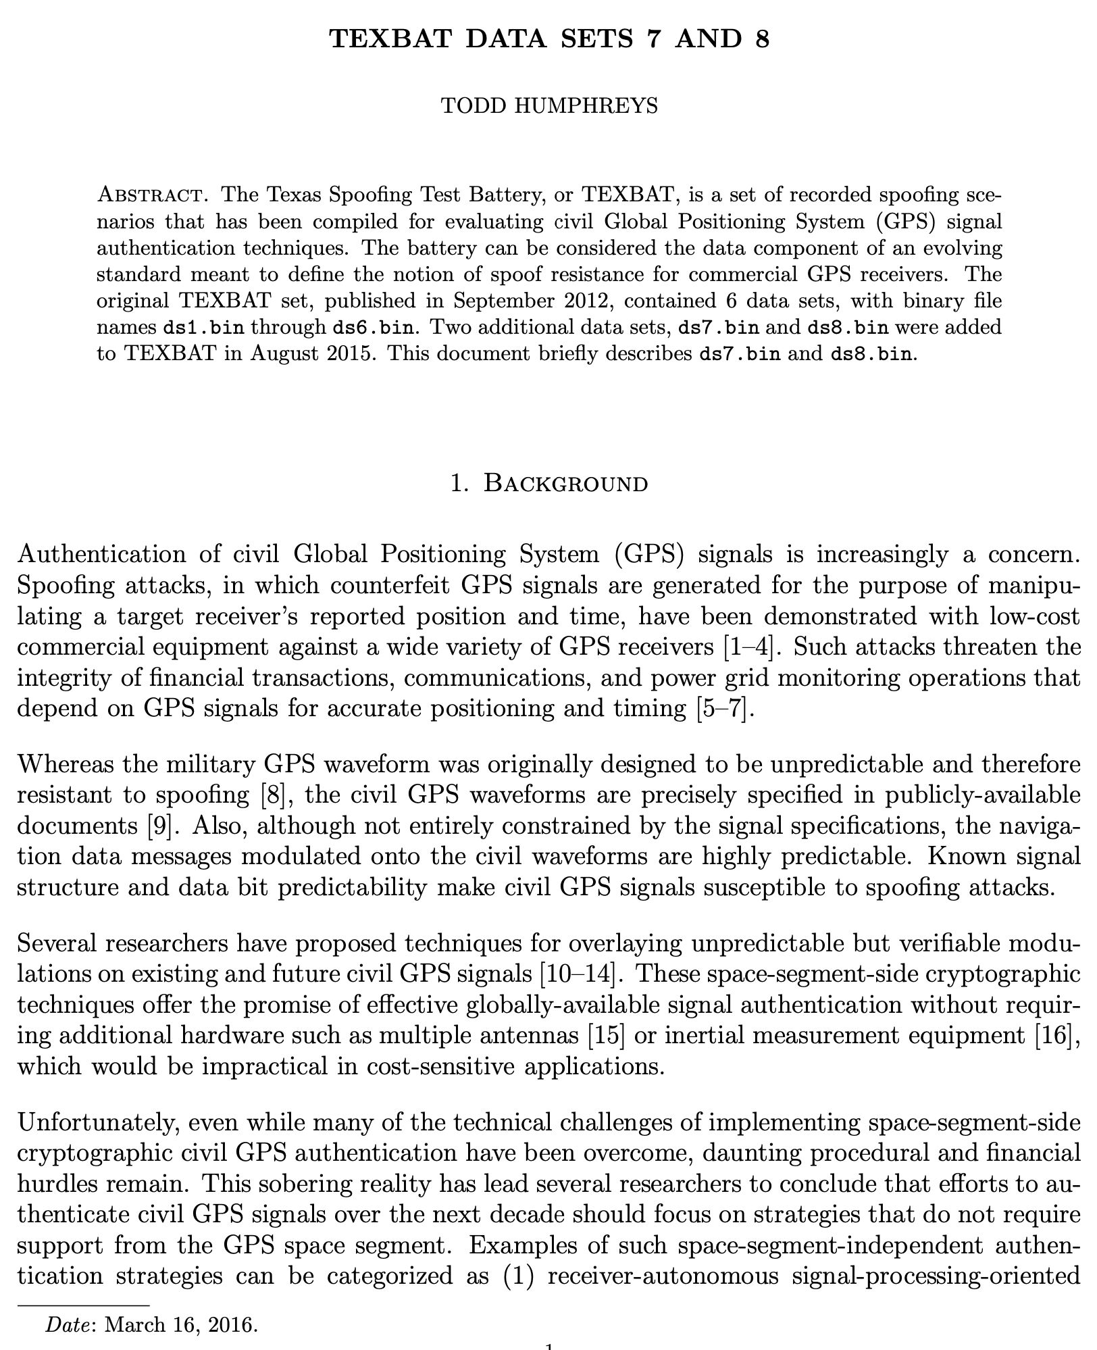
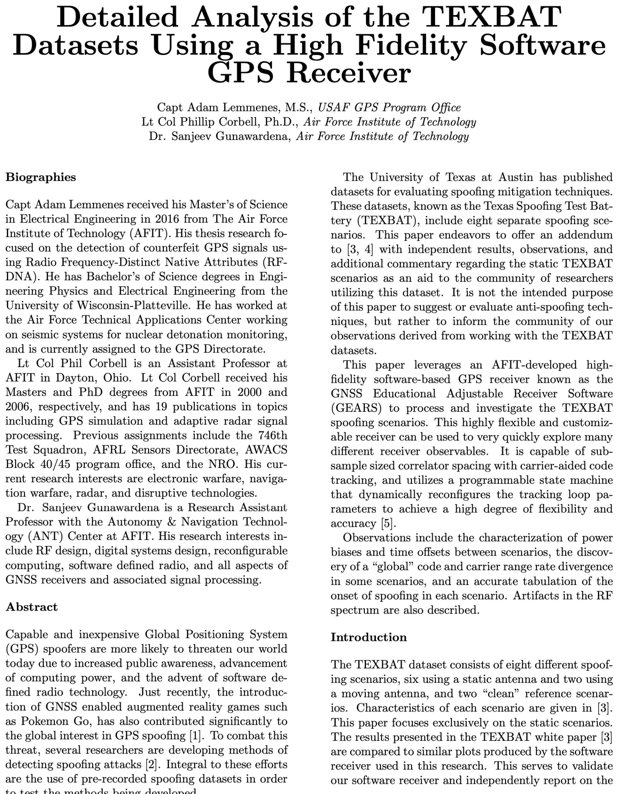
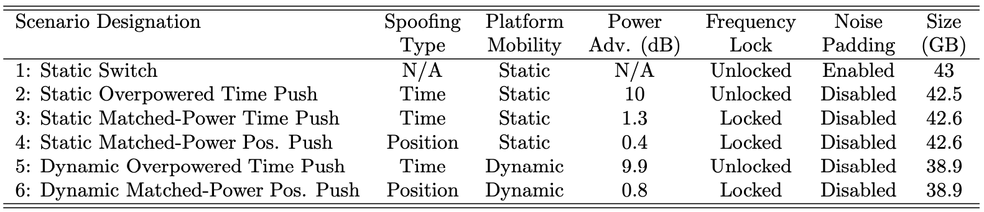
Dataset : TEXBAT(Texas Spoofing Battery)

Slide 15
Exploratory Data Analysis in TEXBAT
The dataset is composed of binary files :
required to process it through gnss-sdr software
Based on the setup(config file), it generates log of variables from different modules.
From the extracted geojson file, I visualized variables with comparison between normal vs. spoofed data.

Slide 16
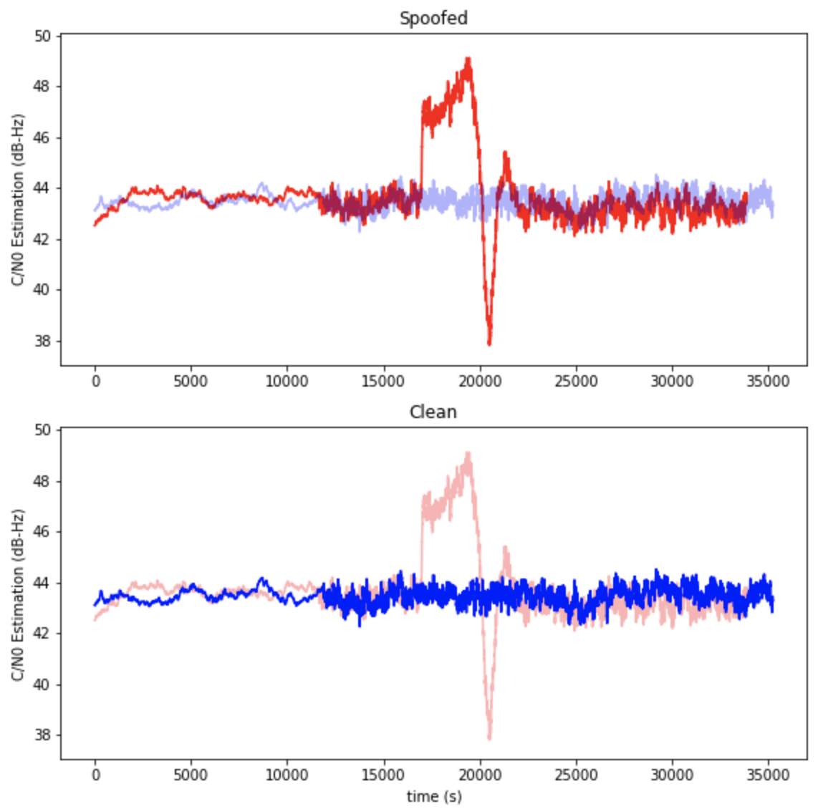
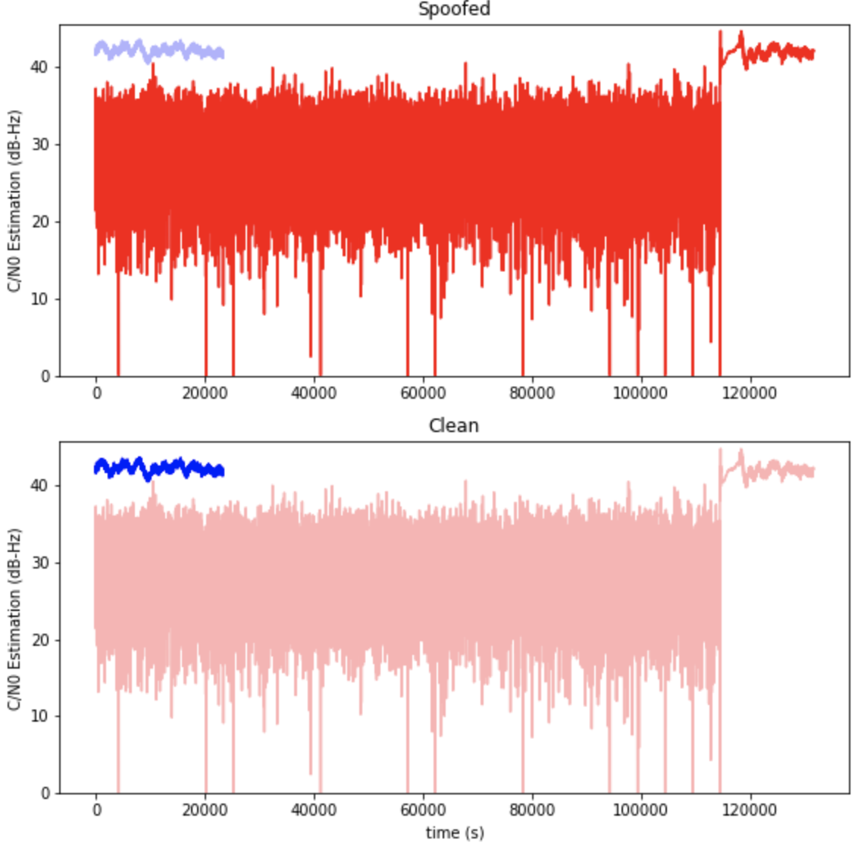
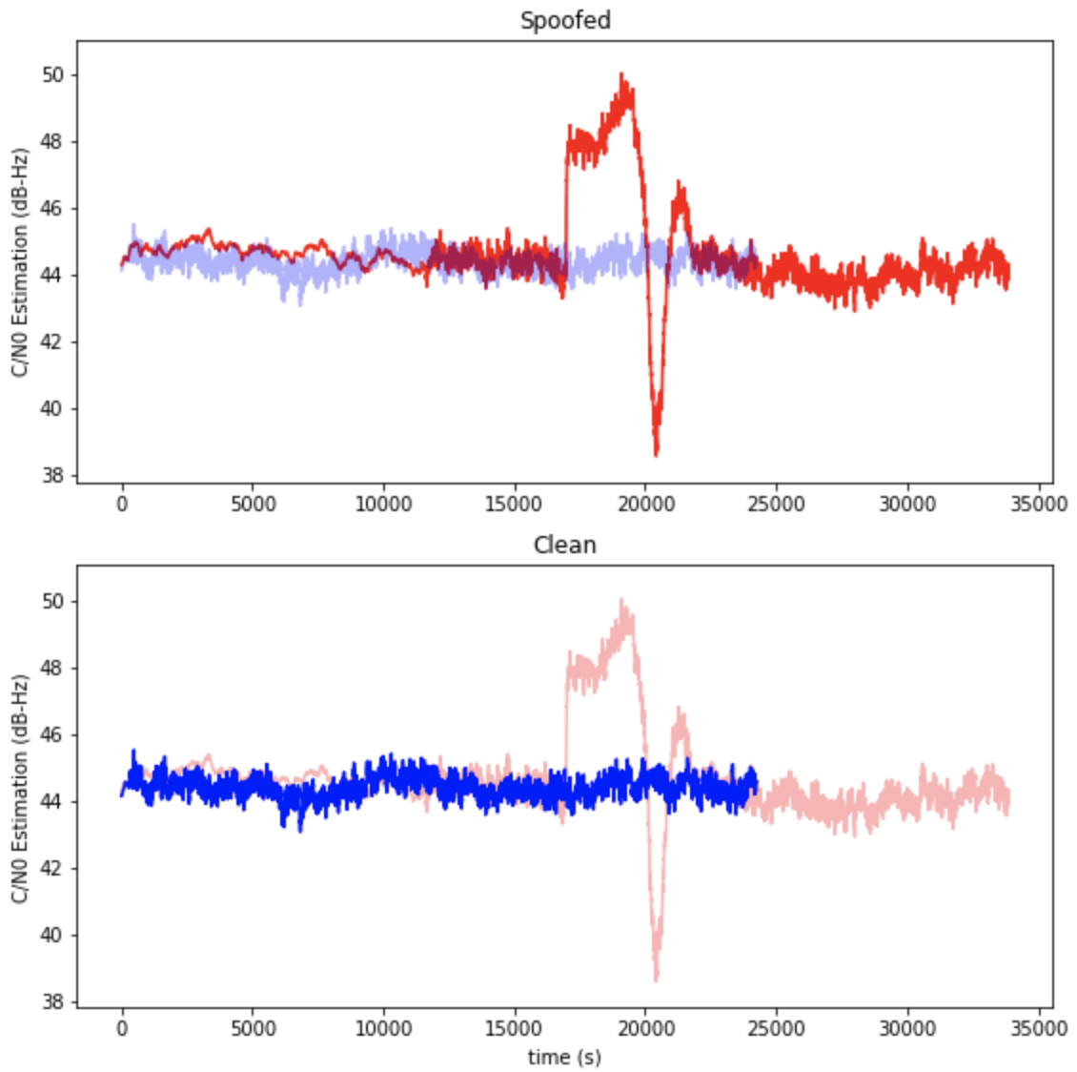
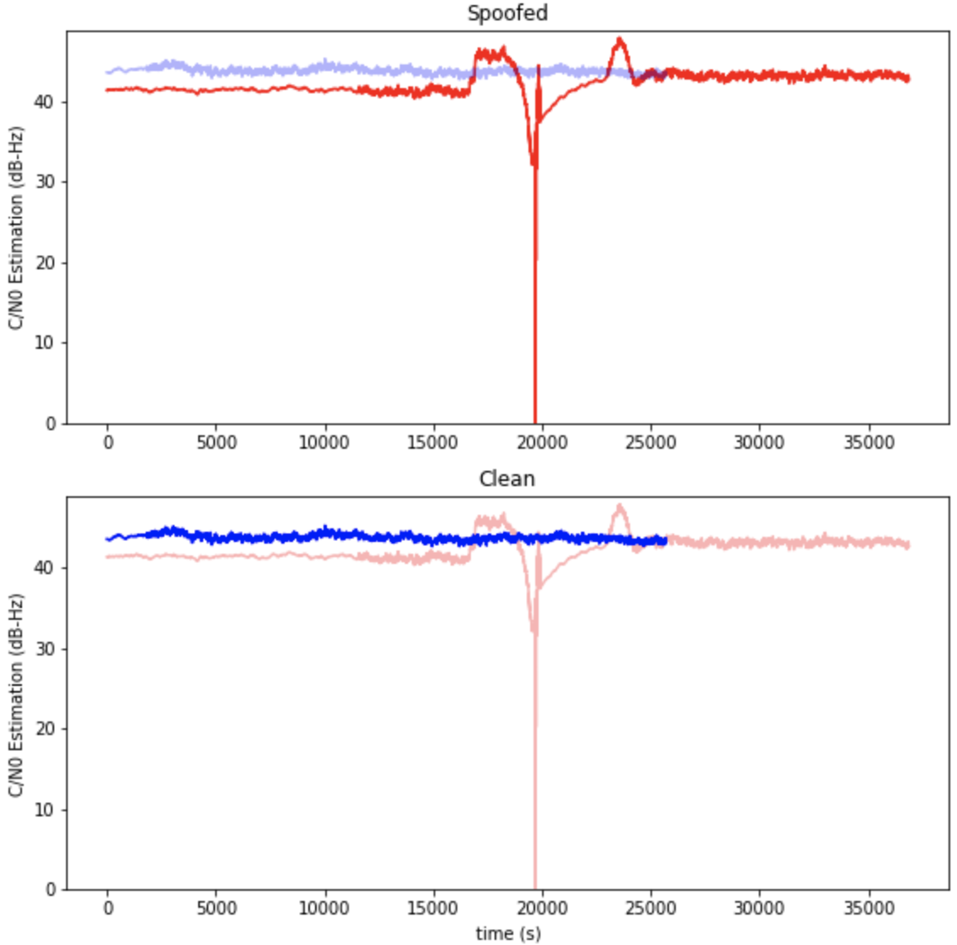
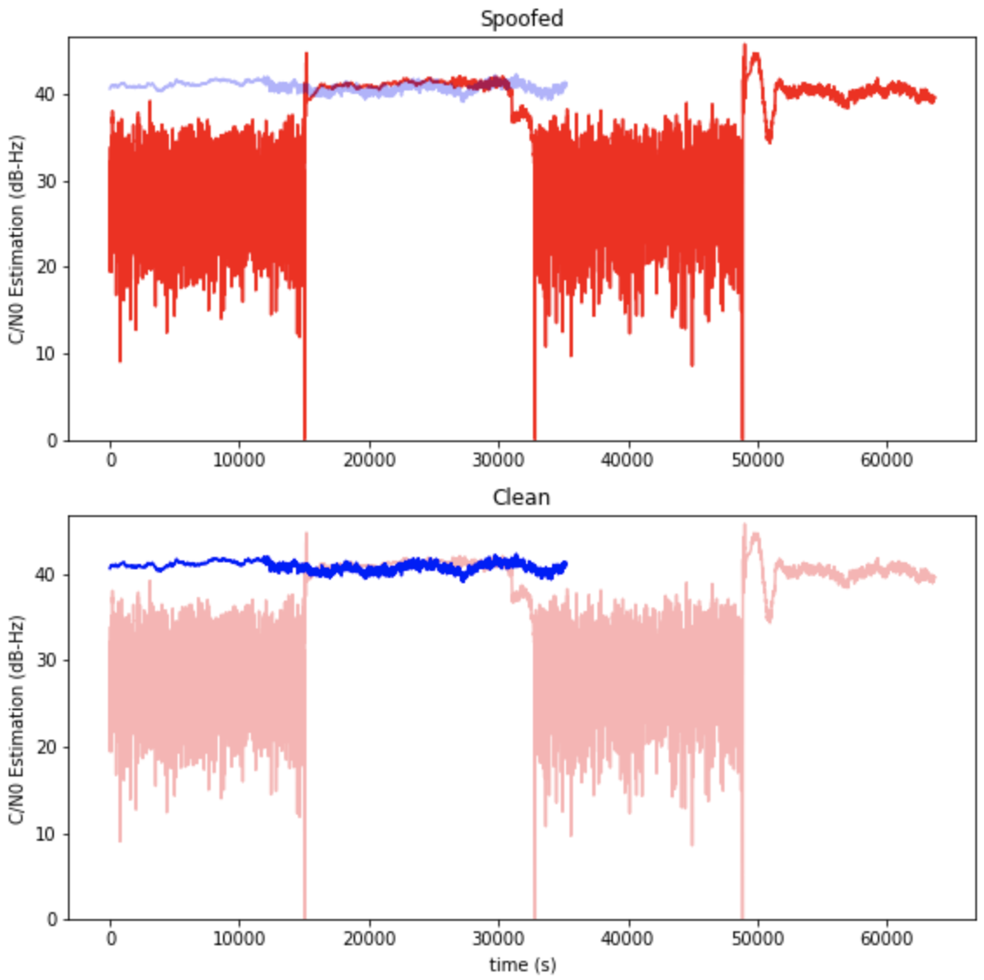
Exploratory Data Analysis in TEXBAT - C/N0
C/N0 is totally out of control in all datasets
C/N0 is stable in the stationary status
Shows gradual increase/decrease in motion

Slide 17
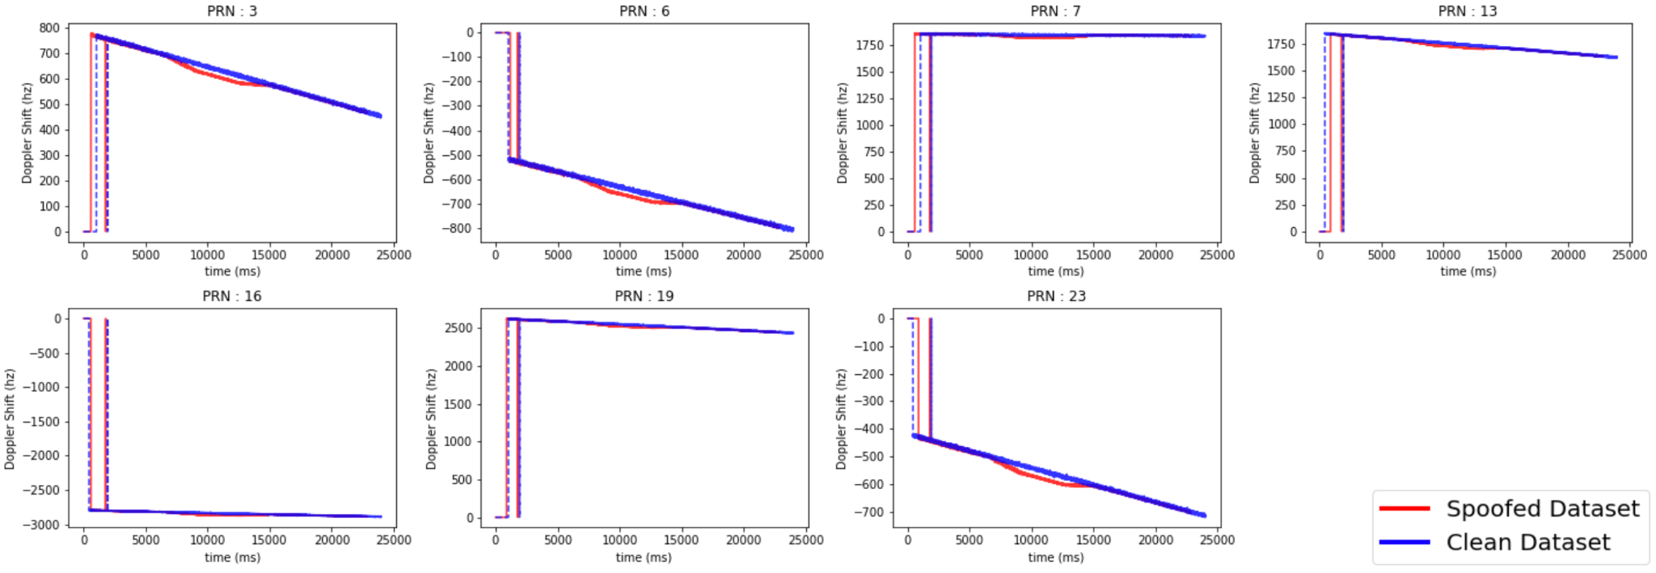
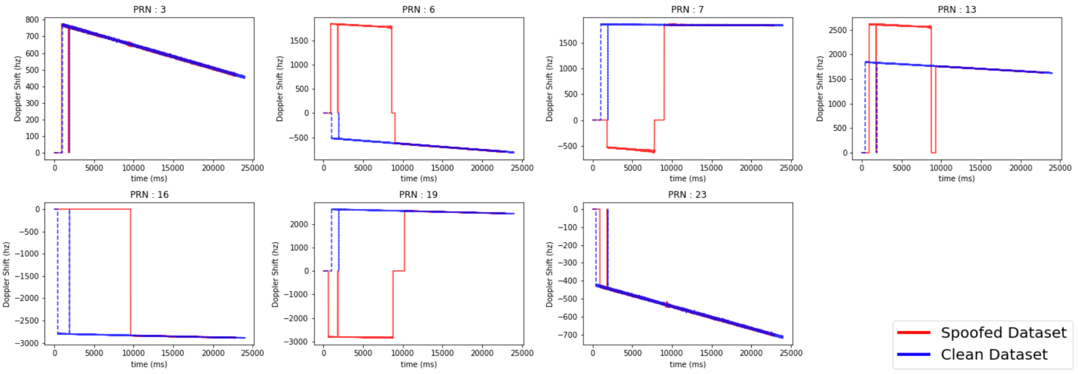
Exploratory Data Analysis in TEXBAT - Doppler Shift
Pattern 2 :
Abrupt extreme jump/drop
Pattern 1 :
Unexpected fluctuation

Slide 18
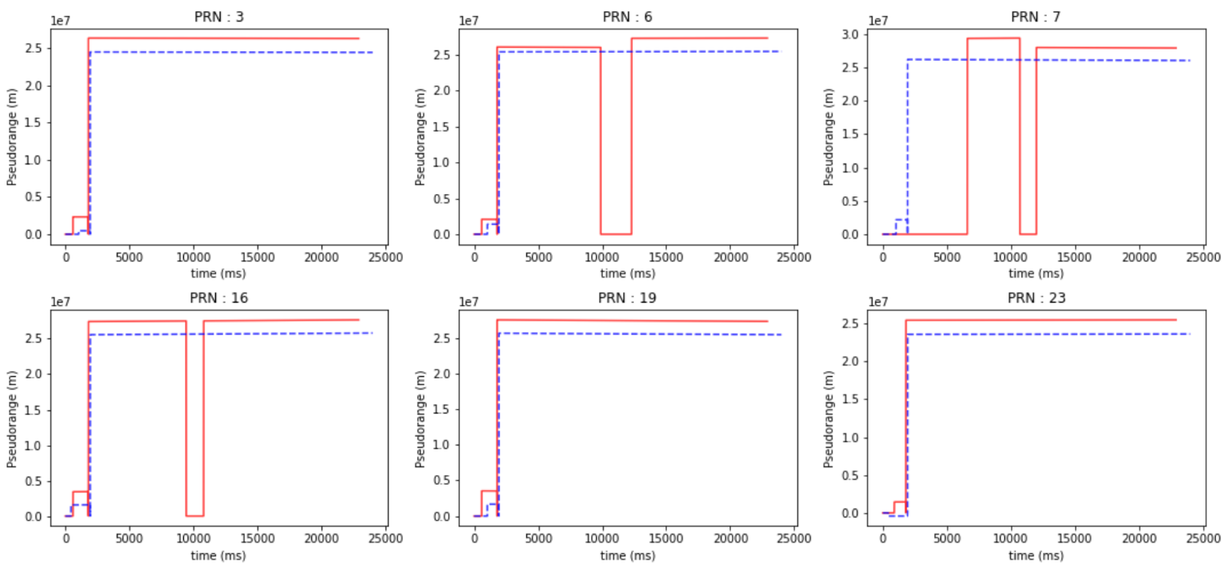
Exploratory Data Analysis in TEXBAT - Pseudorange
Abrupt extreme jump/drop
has been observed

Slide 19
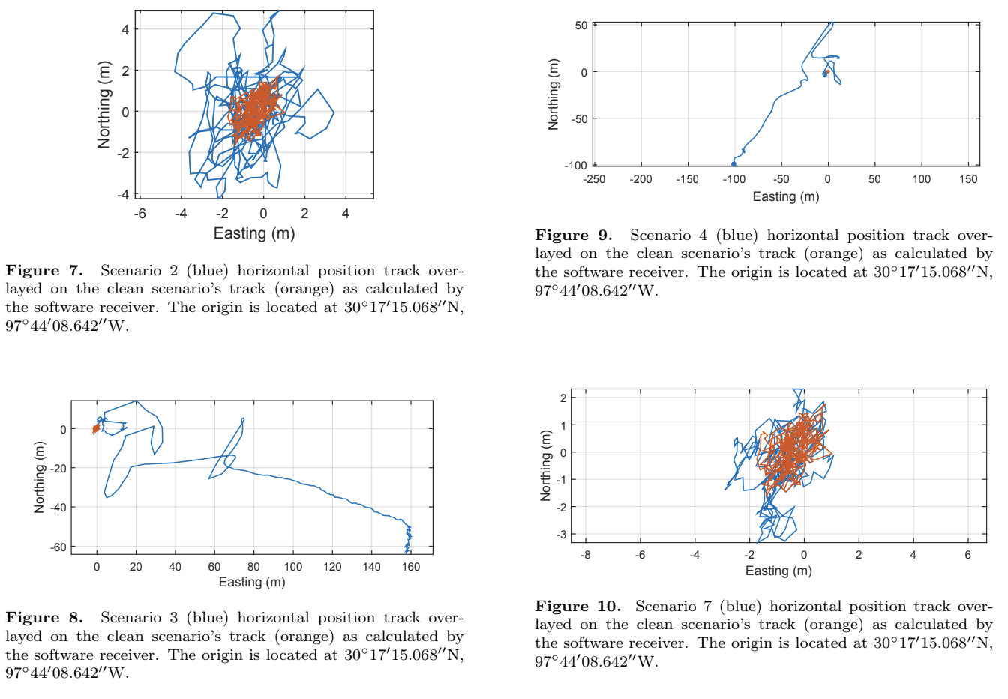
Exploratory Data Analysis in TEXBAT - PVT (To be spoofed)

Slide 20
Motivation
Spoofing signal cannot be exactly the same with the original :
It’s almost impossible to make every variables as same as the original signal is while distorting the target variable(mostly PVT).
Monitoring individual variable may not work :
Aggregate multiple variables from different modules
Anomaly detection typically works well on this :
Frequently used in industrial / netsec area

Slide 21
Variables used for the task
prompt_i : Value of the Prompt correlator in the In-phase component.
prompt_q : Value of the Prompt correlator in the Quadrature component.
cn0_db_hz : C/N0 estimation, in dB-Hz.
carrier_doppler_hz : Doppler shift, in Hz.

Slide 22
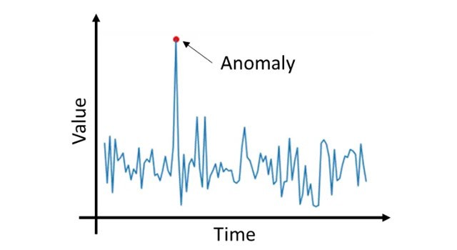
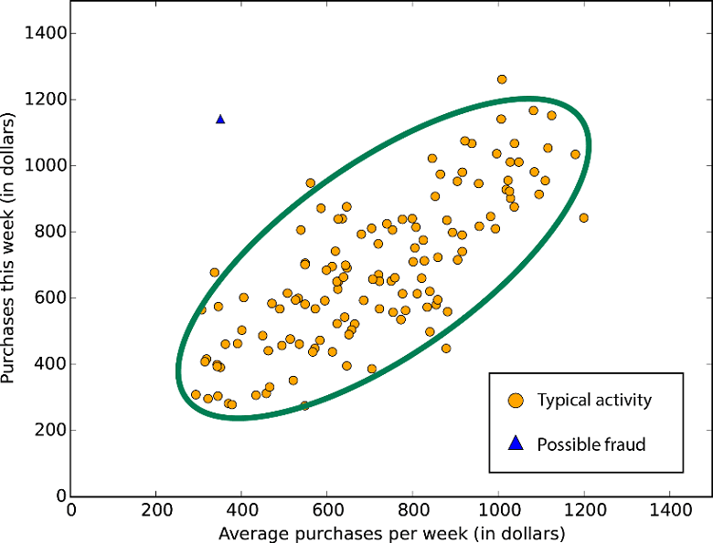
Anomaly Detection
Anomaly detection :
Detecting the abnormal pattern which doesn’t go along with its neighboring data.

Slide 23
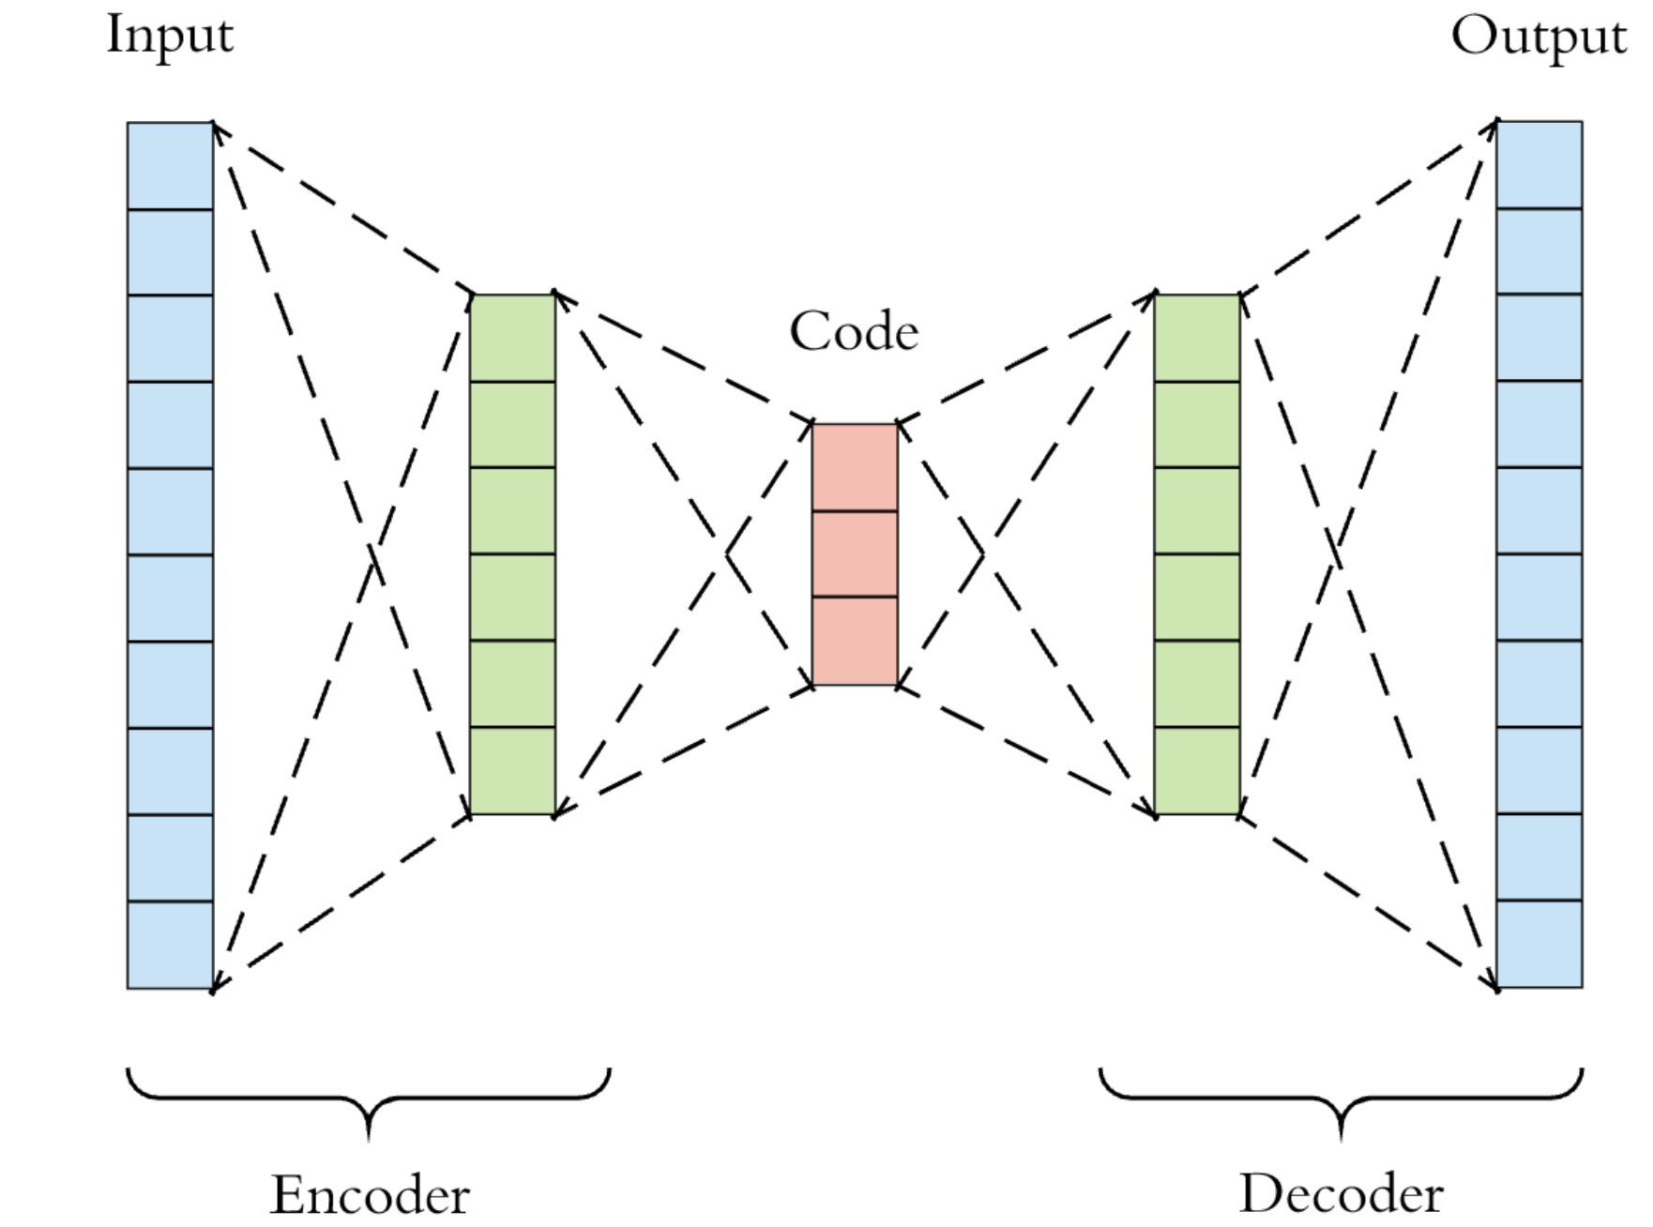
Deep Learning model for the task : Autoencoder
Autoencoder for Anomaly detection :
Training the model to predict as same as input
Then, the model is trained to have less error
for the normal input.
On the other hand, the model has relatively
huge error on abnormal pattern.
By setting the threshold of error,
it’s possible to set its sensitivity.

Slide 24
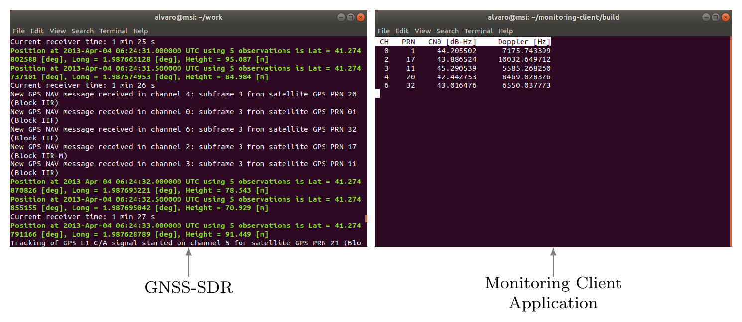
System overview
Modified
gnss_synchro.proto
Protocol buffer
from Google
socket comm
to transmit
train.ipynb
Feed the saved log file
collector.py
detector.py
Parse the data, and feed it to the model

Slide 25
Functions
monitoring_client.cc
collector.py
socket communication with python code
select the variables to send
print out the streamed data
receive data from the socket comm
parse the raw data
save the parsed data into csv file
train.ipynb
detector.py
read the data from csv file
preprocess data - diff()
normalize data - standardscaler()
build and train a model - tensorflow
save the model
receive data from socket comm
parse the raw data
load and restore the model
feed the data to the model
set alert based on error

Slide 26
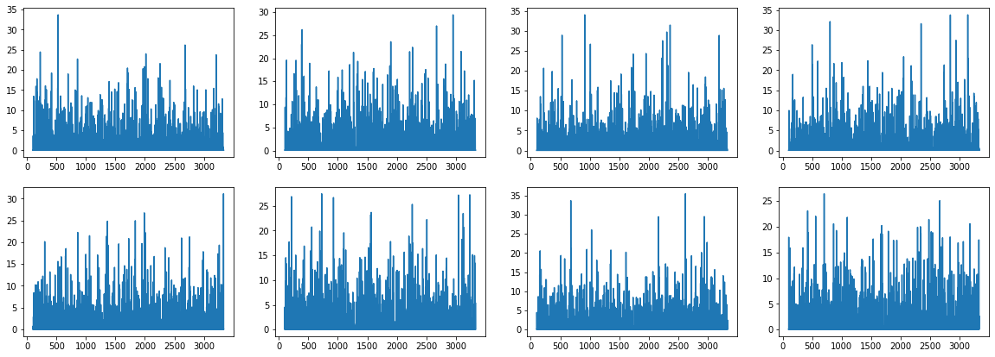
Result - errors from clean data
➡️ Set threshold = 50 based on the observed error graph above

Slide 27
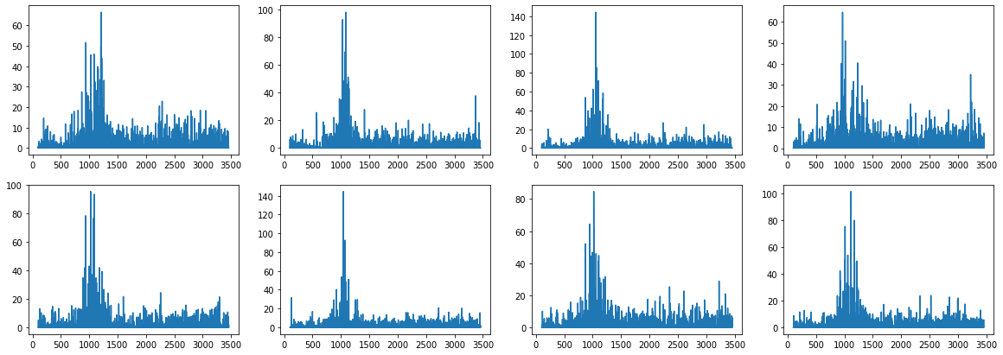
Result - errors from spoofing data
➡️ Overall, the model detected 34 out of 40 spoofing cases (85%)

Slide 28
Limitation
Hard to test with real data :
Testing with spoofing signal is not easy
Limited variables :
Monitor block doesn’t have all variables from GNSS-SDR
Processing speed :
Not working robustly in real-time

